Slide 1


My seminars
Lennard de Ridder
2IBM07

Slide 2
Attended seminars
Cross generational Marketing, by Joeri Van den Bergh on 18 October 2016, in A4 campus Kantienberg at 15:00
Social Europe, by Stefaan Hermans on 15 November 2016, in A3 campus Kantienberg at 15:00
The key to investing, by Pierre Huylenbroeck - Geert Van Herck - Stephan Desplancke on 11 October 2016, in Auditorium Quetelet at the faculty of economics and business of the University of Ghent at 19:00 (External by Capitant)
Fundamentals of Adwords, by Dimitri Dekdouk on 6 October 2016, in A3 campus Kantienberg at 18:30 (External by Google)
Crowd funding, by Geert Stox on 28 February 2017, in A2 campus Kantienberg at 15:00

Slide 3
Cross generational marketing: summary of seminar
Mister Joeri Van den Bergh had a really interesting seminar about the next generation: NXTGen, which consist out of X, Y and Z and how their behaviour requires marketeers to approach them differently if they want to keep their customers. He had three main points about this:
1. Snapiness: Change the media platforms you are using
2. Dreaming of a better world: Make sure you address more than only your business aspects, try to do something for the world
3. I am making it: Create engagement

Slide 4
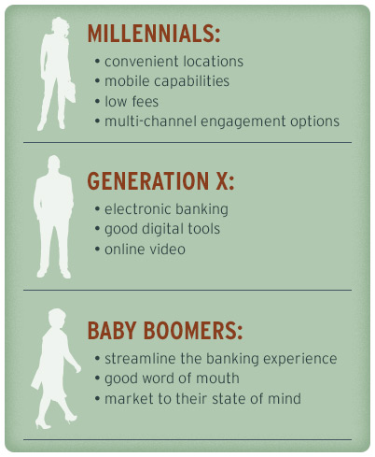
Cross Generational Marketing: Own research
If you want to approach every generation correctly, you need to make a distinction between their generation. There is however a balance which is applicable to all three and that is what you need to find. The following elements are essential to offer to your customers:
Trust
Reliability
Personalized experience
Ease of use
Baby boomers are at the end of their ‘spending power curve’, but millennials will be the next ones to spend in your business
(Logsdon, 2015)
(Logsdon, 2015)

Slide 5
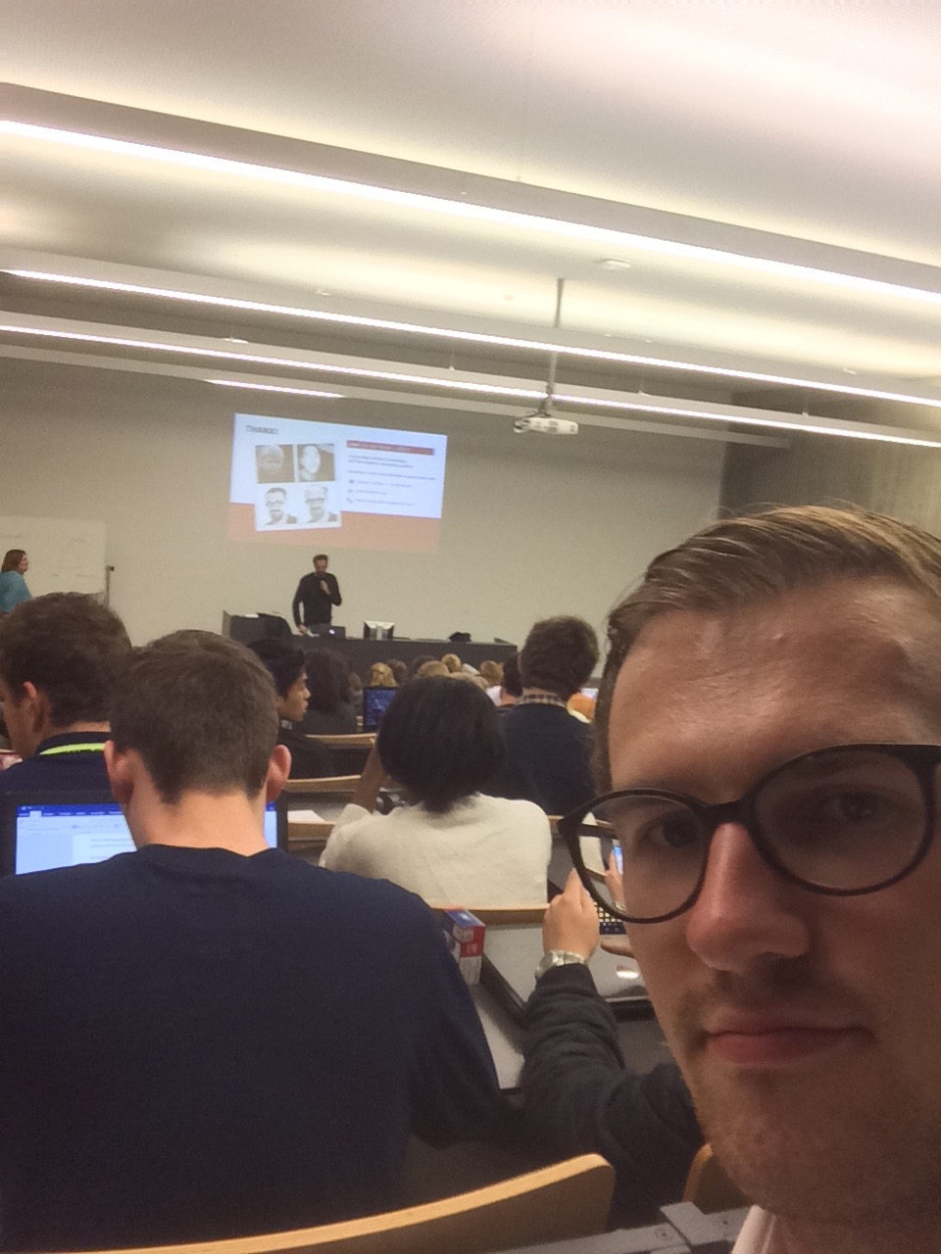
Cross Generational Marketing: Reflection
In my opinion, this was the most interesting seminar organised by Artevelde University College. I have learnt a lot of ‘new’ things about marketing to different generations. I already heard some theory about the differences between generations X, Y and Z, but Mr. Van den Bergh really explained it well. After this seminar, I am more aware of these differences and I think that it is something to really take into account once I start working in a real business.

Slide 6

Social Europe: Summary
Mr. Hermans spoke really passionately about the European Union, how it is questioned and that it are difficult times. He told us that the EU is planning on a new social policy based on three pillars:
1. Funding coordination
2. Social acquis
3. New policy tools
The EU wants to focus more on the future of all citizens of the EU, by creating a fairer job market. Graduates and young professionals are also their top priority in the new plans.
(PNGPIX)

Slide 7
Social Europe: Own research
The European Union has introduced their new social policy in order to make sure that their projects have a positive impact on people. This includes aiding social entrepreneurship via financing (microfinancing), funding programmes to help graduates and young professionals to get a job, and to create a fair job market. The latter means that the same job should get the same wage. Nowadays, Eastern-Europeans get a way lower wage than their Western-European colleagues, while performing the same job.
(Employment and social affairs, EU)

Slide 8
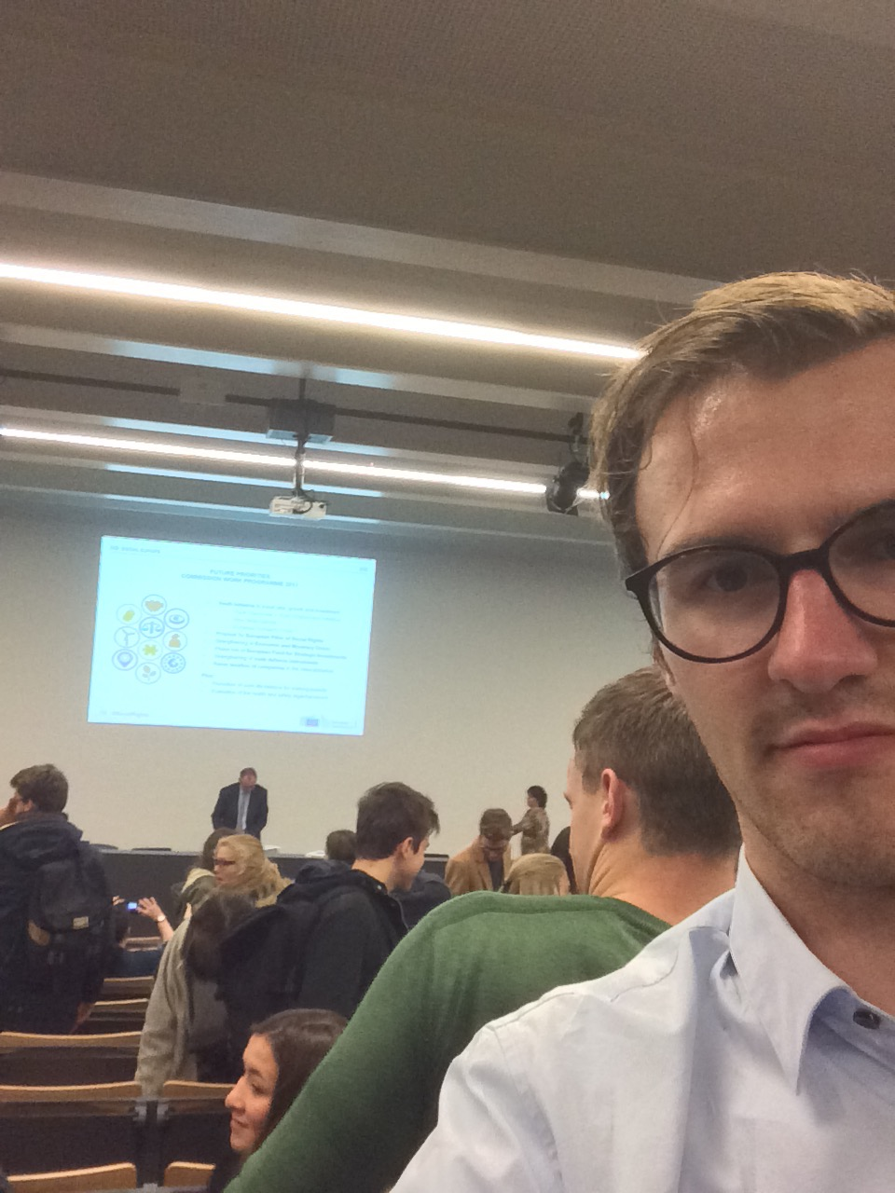
Social Europe: Reflection
This was a seminar of which I had very high expectations. However, Mr. Hermans gave more of a promotional talk about the EU in stead of giving us some valuable information (or have a good debate). When I asked him a question about the fact that Polish workers are working here way below a fair wage, he just told me that I had been mis-informed and this is not true. I was really irritated by this, because he did not let me ask another question.
The initiatives the EU takes to tackle the problems they are facing now, were interesting though.

Slide 9

The Key to Investing: Why I chose this seminar
I chose this seminar because I have attended almost every seminar organised by Capitant in the past 3 years. I am really interested in finance and financial markets. I have learnt that Capitant offers great lectures by really good speakers.
(Capitant)

Slide 10
The Key to Investing: Summary
The seminar was divided in three parts, but Pierre Huylenbroeck was the most interesting speaker of them all. He is owner of Mister Market Magazine and explained to us how investing with a small amount of money could still be profitable to us. He explained to us how we could build a professional portfolio and spread our risks. After this seminar, Nino Galle and I tried to build our own model, which we used in the Stock Exchange game of KBC (KBC beleggerskoers). Using this model, I gained an ROI of 24% in only 5 months. The model tells you how to eliminate your emotions and provides you with a rational choice model.

Slide 11
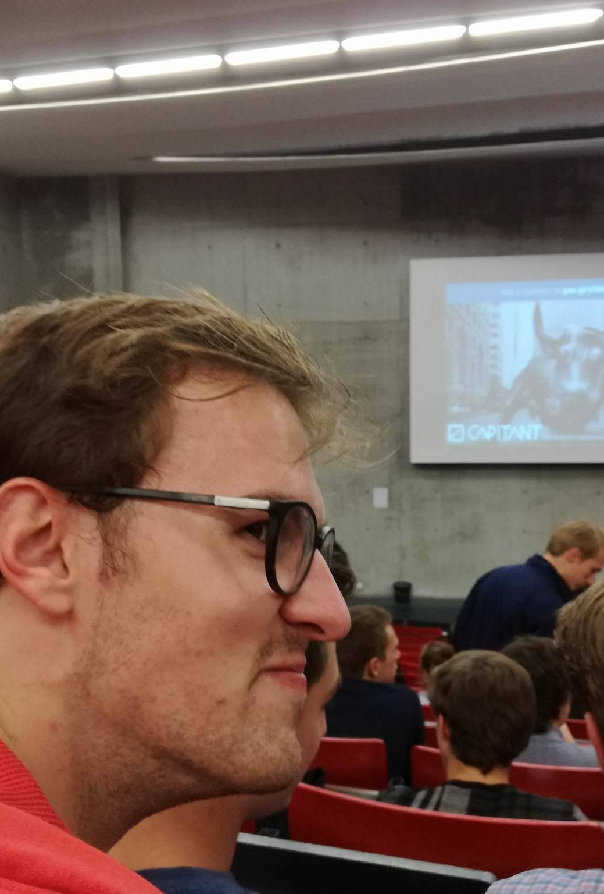
The Key to Investing: Reflection
This was one of my favorite seminars of the year. Pierre Huylenbroeck gave us a really good insight in what it takes to become active on the stock market and I have been preparing myself ever since. Before the seminar I had a strong interest as well, but Mr. Huylenbroeck gave us the tools to really start.

Slide 12
Fundamentals of AdWords: Why I chose this seminar
Because I attended the Google Digital Masters Academy, I had access to multiple seminars by Google. AdWords was only one of the four seminars I attended. I think that if you want to pursue a career in sales and marketing, the tools by Google are essential if you want to succeed.

Slide 13
Fundamentals of AdWords: Summary
The seminar gave us an insight in how Google makes a profile of you, even if you do not have a Google account. In this way, marketeers can target you specifically and you will only receive relevant information. In your Google account you can look up your profile which Google has made of you. I checked it after the seminar and (not surprisingly), it was really accurate. They told us how we could target people using the AdWords platform and taught us the basics of setting up campaigns and what it takes to build a really good one. The thing which I liked most was that if you have the highest quality advertisement, you can get away with quite a low bid, if you compare it to a bad quality ad, they will have to pay way more. (But even then, a high quality ad is more likely to be shown).

Slide 14

Fundamentals of AdWords: Reflection
I really liked the series of seminars provided by Google. They gave me an insight in what it takes to set up a professional marketing campaign and how you can reach a specific audience, which will also limit your costs. I started realizing that everything you do on the Internet will have an effect on what you will see as advertisements on other websites, but I have also started to appreciate the fact that they are tailored to me.

Slide 15
Crowd Funding: Summary
This seminar was about crowd funding and how start-ups and growing businesses can make use of it. If the public believes in a project and they are willing to fund it, you are likely to receive lots of money. There are some downsides as well, as you need to put something in return. With a loan it is simple, you get an interest of x%, but with crowd funding, you can get returns in physical goods as well, or it can just be a gift.

Slide 16
Crowd Funding: Own Research
Crowdfunding really lowers the barrier to start up a business. If you have trouble to reach investors, crowdfunding could be your cup of tea. However, is it wishful to have untested companies reaching out to investors through crowdfunding? (Forbes) Experts say that companies who have a game-changing technology and can generate their own finances after the first financial injections have a chance of succeeding. For the other companies (exemptions to the rule are omnipresent of course) will just postpone their problems to find investors to the second round.
(Forbes)

Slide 17
Crowd Funding: Reflection
I really did not enjoy this seminar. Geert Stox was really into some movie which was funded entirely through crowdfunding, but at a certain moment, the fragments of this movie were misplaced and totally not in line with the subject. He could have made it really interesting, but I think he failed in this. I would have liked him talking about some recent projects (apart from the movie), which were great successes or big fails and what some criteria are to set up a successful crowdfunding campaign.

Slide 18
Sources
Capitant. (n.d.). Capitant Logo. Capitant.
Google. (n.d.). Google Logo. Google.
Logsdon, Z. (2015, March 3). cross generational marketing strategy. Retrieved from http://www.thirddegreeadv.com: http://www.thirddegreeadv.com/cross-generational-marketing-strategy
PNGPIX. (n.d.). European Union flag.
Posillico, P. (n.d.). quotes/palma-posillico-quote-there-is-no-such-thing-as-failure-only-feedback-were-all. Retrieved from http://www.quotehd.com/: http://www.quotehd.com/quotes/palma-posillico-quote-there-is-no-such-thing-as-failure-only-feedback-were-all
The employment and social innovation programme (2014). [Motion Picture].
Tsui, V. (n.d.). Entrepreneurship. Harvard Business Review.
Van den Bergh, J., & Behrer, M. (n.d.). How cool brands stay hot.
Forbes, The problems and promises of crowd funding

